Slide 1

Online Influencer Product Recommendation System
Module 2: Model Architecture
& Training
Group 23
Chen, Xinyao
Niravane, Anagha
Qiu, Emily
Peng, Yulin
Liu, Yijia

Slide 2
Table of Contents
Project Introduction
Model Overview
Model Establishment & Tuning
Stage 1: Recall
Stage 2: Fine Ranking
Stage 3: Re-Ranking
Final Output
Conclusion & Future Work

Slide 3
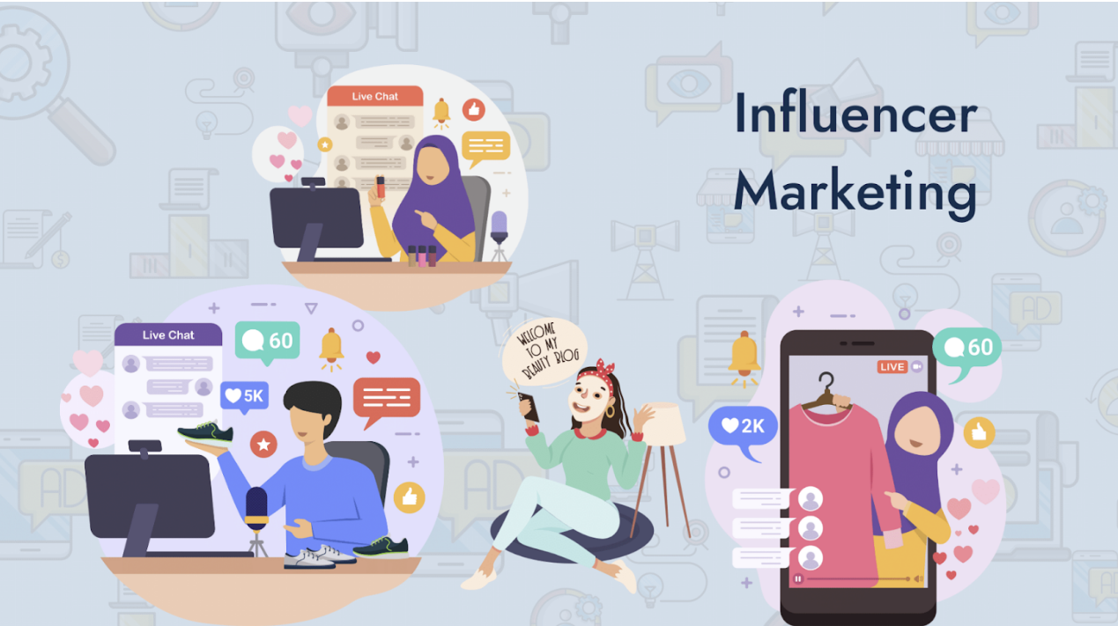
Project Introduction
Background: With the rise of social media and e-commerce integration, influencers have become a key force in driving online sales through product promotions. Selecting the right products to promote remains a challenge, as influencers need to balance market trends with their personal brand and audience preferences.
Project Goal: Develop a product recommendation system tailored for online influencers on social media platforms.
By analyzing both trending products and influencer characteristics, our system helps creators identify the most suitable products to promote, maximizing their sales potential and commission earnings.
This data-driven approach not only enhances influencer revenue streams but also optimizes brand partnerships by ensuring more effective product placements.

Slide 4
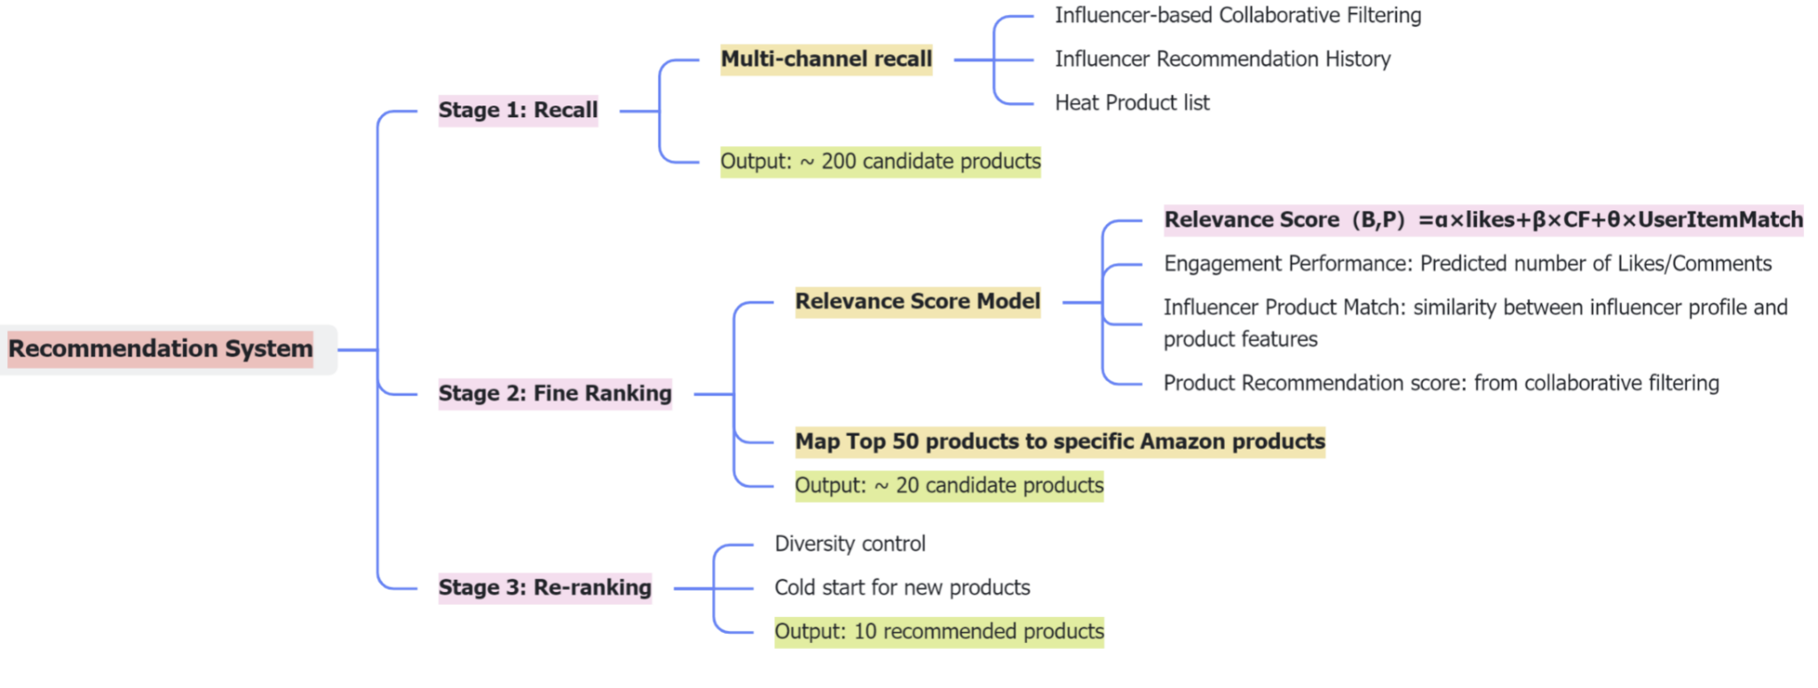
Recommendation Model Overview
Three stages of the influencer product recommendation system

Slide 5
Stage 1: Recall
Stage 2: Fine-Ranking
Stage 3: Re-Ranking
Output
Goal: Filter out a batch of potentially relevant products from a massive candidate pool as input for subsequent sorting.
Benefit:
Quickly filter out relevant content from huge data pools to reduce the amount of calculations.
Ensure that content that influencers may be interested in is not missed and ensure the coverage of recommendations.
Method: Multi-Channel Recall Strategy to improve diversity
Influencer Collaborative Filtering
Influencer History Recall
Popularity Recall

Slide 6
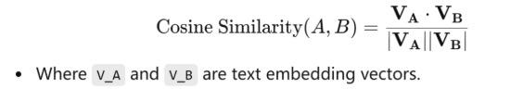
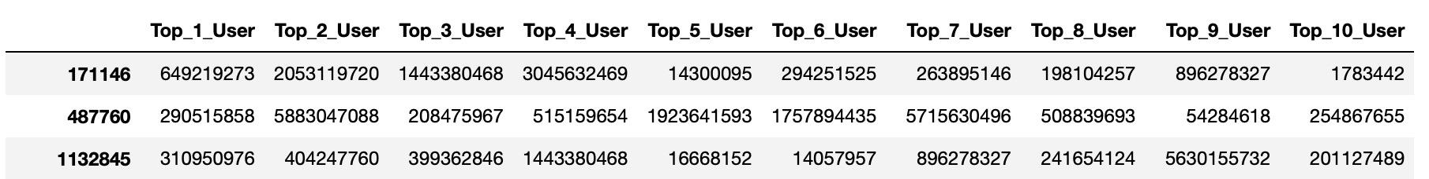
Influencer-based Collaborative Filtering
Stage 1: Recall
Stage 2: Fine-Ranking
Stage 3: Re-Ranking
Output
Calculate influencer similarity & Derive similarity matrix
Proprocessing post captions: Cleaning & tokenizing
Vectorizing: Used TF-IDF to convert text into numerical representation
Computing Similarity: Used cosine similarity to measure the similarity between captions
Aggregating Similarity Score: Calculated similarity score for each influencer and output the similarity matrix
Similarity Score = 0.7 * post_similarity + 0.3 * follower_similarity
Identify top 10 similar influencers for each influencer
Used KNN (n_neighbors = 11, including self)

Slide 7
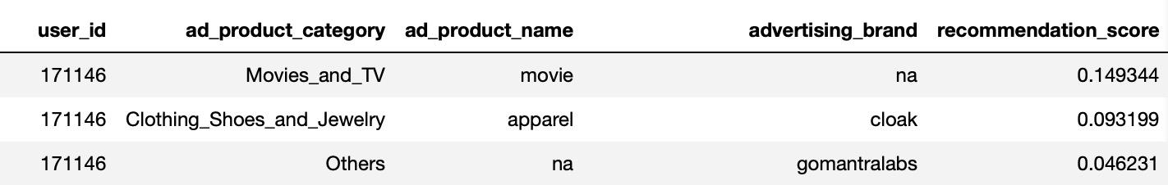
Product Recommendation Score from Similar Influencers
Stage 1: Recall
Stage 2: Fine-Ranking
Stage 3: Re-Ranking
Output
Extract Relevant Products
Identify products promoted by similar influencers (from previous step)
Filter out products already recommended by the target influencer
Calculate Product Recommendation Score
Build an Influencer-Product Database
Data includes: Influencer id, Product, Recommendation Score
Engagement score (post level) = 0.4 * likes + 0.6 * comments
Aggregate engagement score for each product
Recommendation score:
Score(B,P)=∑i∈Similar Influencers​Similarity(B,i)×Engagement Score(i,P)
Select Top Recommended Products
Retrieve top 200 products with the highest scores for Fine Ranking

Slide 8
Stage 1: Recall
Stage 2: Fine-Ranking
Stage 3: Re-Ranking
Output
Goal of Fine-Ranking: The core is to establish a relevance score model.
Score the candidate products in the ranking stage
Filter out irrelevant or low-performance products
Generate a smaller list of high-quality products (~ 20 items).
Relevance Score（User B, Product P）= α × Likes+β × CollaborativeFiltering + θ × UserItemMatch
Initial weight: the predicted number of likes take up 60% of the weight, and the others 20%, etc.)
Currently, a hybrid scoring model is used:
benefit: the model part only needs to focus on predicting a certain target (such as the number of likes), which is relatively simple;
weaknesses: requires manual tuning of weights and may not be able to mine the complex relationships between all interactive features.
Future Improvements: be optimized to an end-to-end machine learning model later.

Slide 9
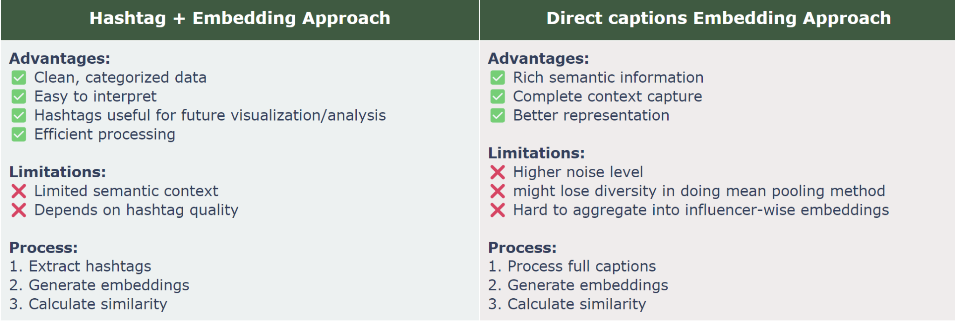
Stage 1: Recall
Stage 2: Fine-Ranking
Stage 3: Re-Ranking
Output
Calculate Influencer - Product Fit
Goal: Create embeddings from Influencer’s captions and product information, then calculate a similarity score from cosine similarity score using pytorch.

Slide 10
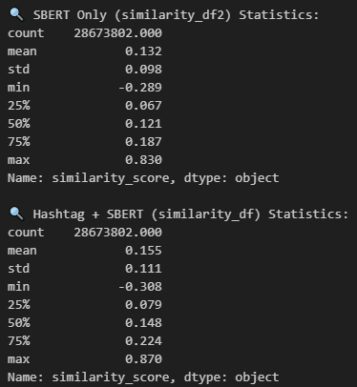
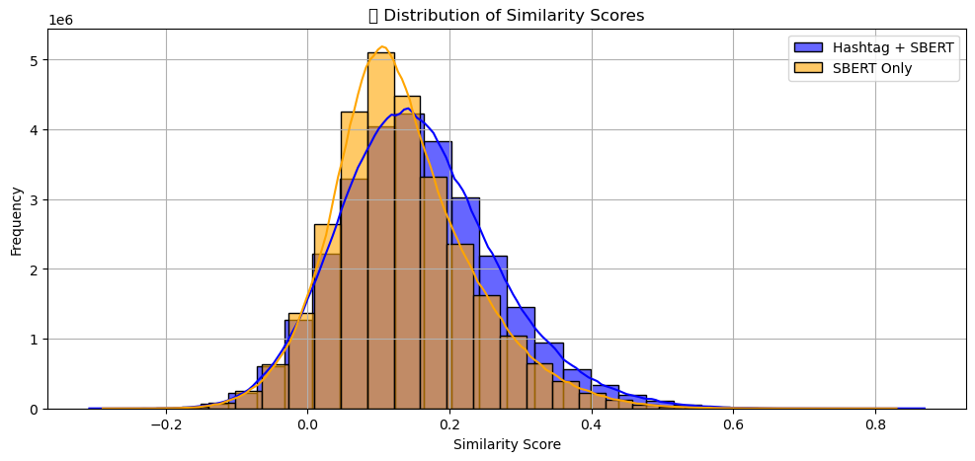
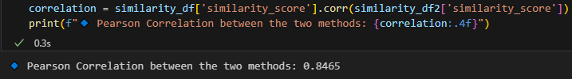
Model comparison
Stage 1: Recall
Stage 2: Fine-Ranking
Stage 3: Re-Ranking
Output

Slide 11
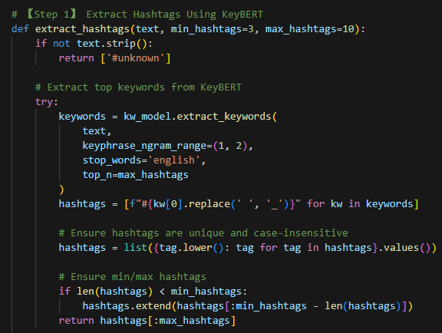
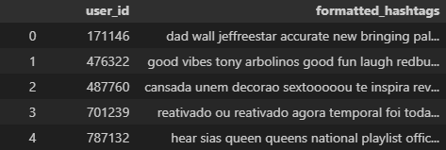
Applying the Model
Stage 1: Recall
Stage 2: Fine-Ranking
Stage 3: Re-Ranking
Output
Since two methods have high correlation, there won’t be huge difference between them.
Thus choose Hashtag + Embedding model for similarity score calculation since it has a higher max score and larger standard deviation which is good for diversity analysis.
Hashtag extraction using KeyBERT
Sample output

Slide 12

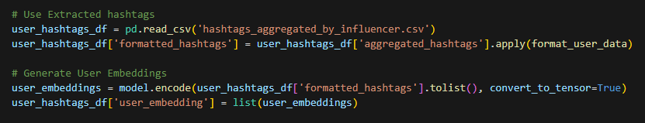
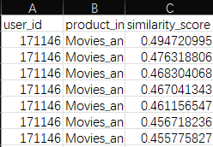
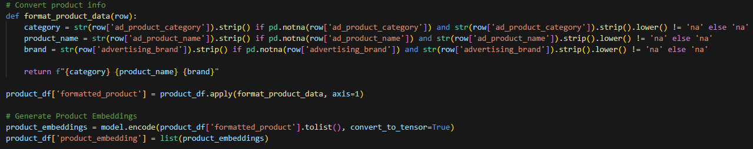
Applying the Model
Stage 1: Recall
Stage 2: Fine-Ranking
Stage 3: Re-Ranking
Output
b. Use SBERT for Embedding
Influencer Caption Hashtags Embeddings
Product Information Embeddings
Sample Output using Cosine Similarity

Slide 13
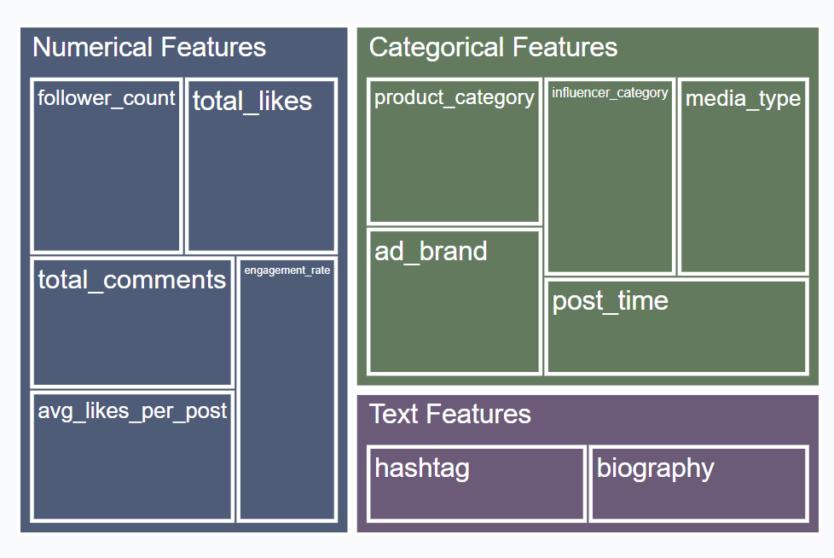
2.1 Engagement Prediction: Multi-dimensional Feature Framework
Stage 1: Recall
Stage 2: Fine-Ranking
Stage 3: Re-Ranking
Output
Input: influencer features + product features + context features
Output: Likes/Comments prediction
Purpose: Divide features into three categories and apply appropriate transformations
Processing Flow: Data cleaning → Feature transformation → Model input
Feature Type | Processing Method
Categorical feature | Interpolation+ OneHot encoding
Numerical features | Median interpolation + Normalization
Text features | TF-IDF vectorization + Keyword extraction

Slide 14
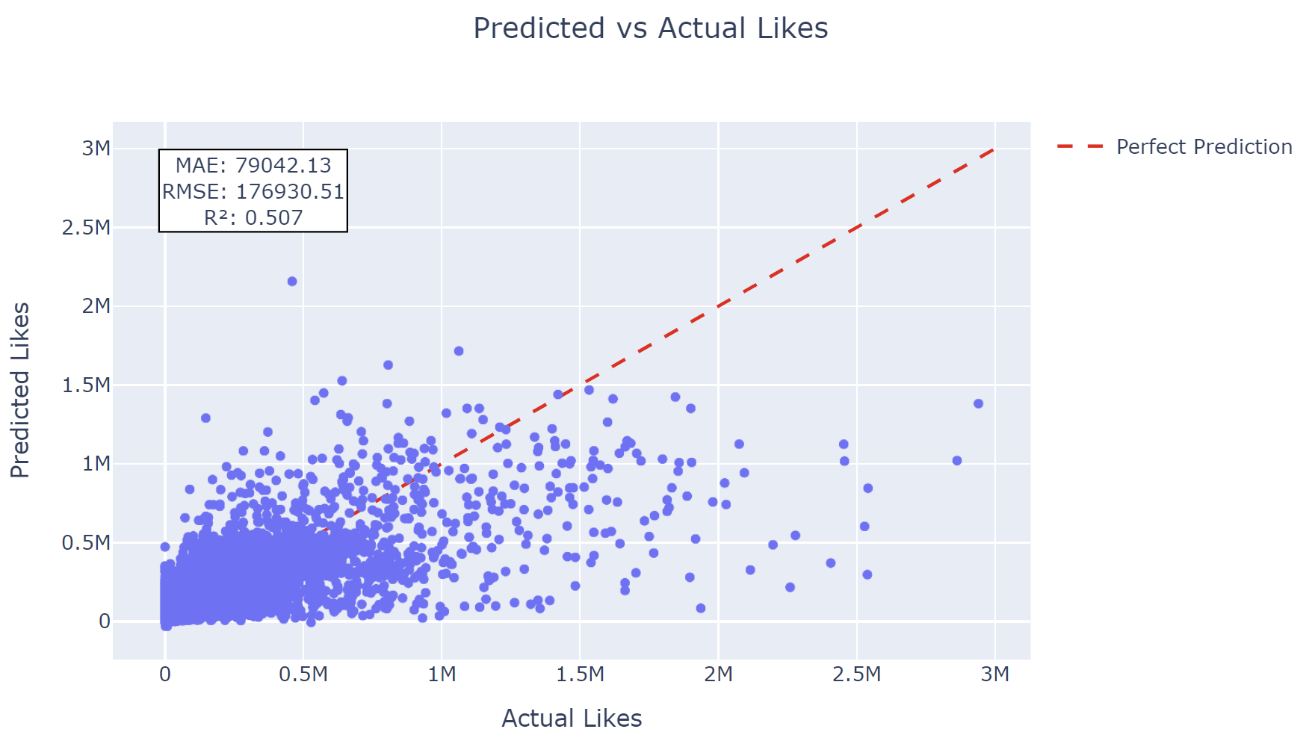
2.1 Engagement Prediction: Model Selection
Stage 1: Recall
Stage 2: Fine-Ranking
Stage 3: Re-Ranking
Output
Divide the dataset into training set and test set (80%, 20%)
Perform LR, Random Forest, XGBoost, LightGBM
Add L1 and L2 regularization and found out best parameters for Light GBM using GridSearch, improving R^2 by 10%
Model | RMSE | R^2 | Improvement
Linear Regression | 189804 | 0.433 | -
Random Forest | 198157 | 0.382 | -2.8%
XGBoost | 179055 | 0.495 | +14.3%
LightGBM | 176930 | 0.507 | +17.1%

Slide 15
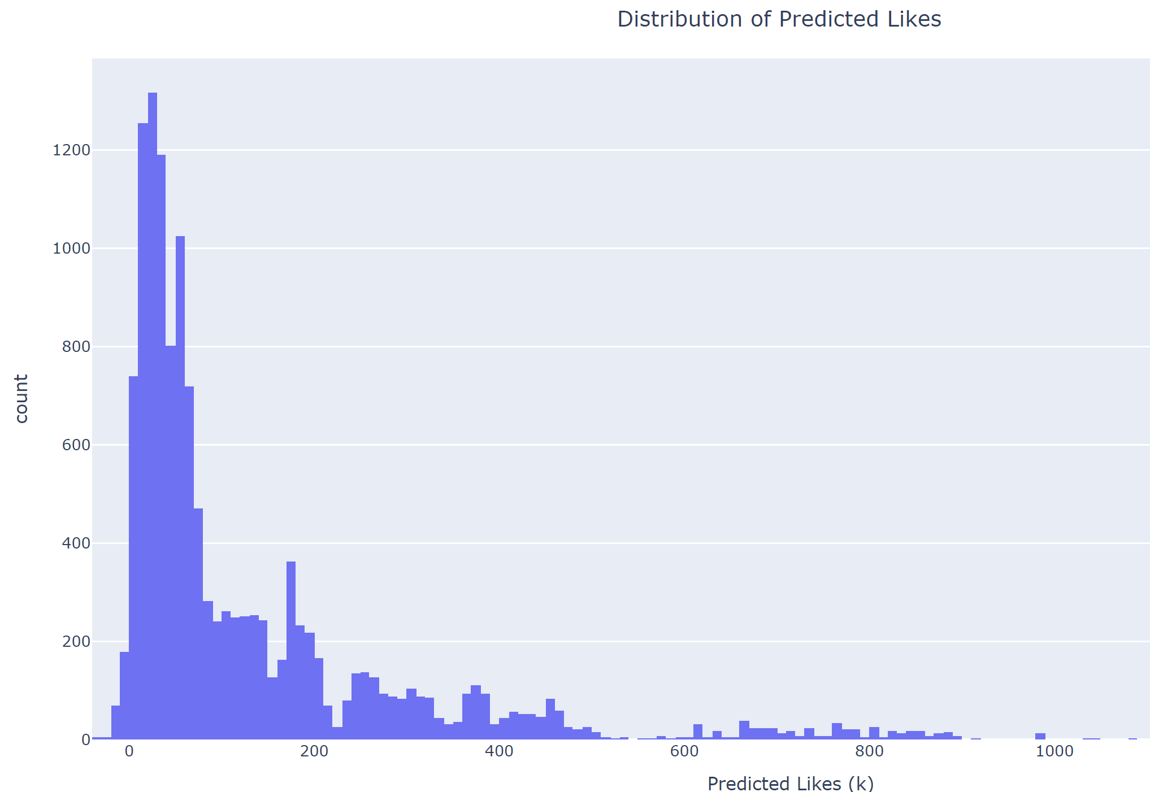
2.2 Engagement Prediction: Distribution of Predicted Likes
Stage 1: Recall
Stage 2: Fine-Ranking
Stage 3: Re-Ranking
Output
Distribution Shape:
Highly right-skewed distribution
Peak concentration in the 0-200k likes range
Long tail extending to 1400k likes
Engagement Patterns:
Majority of posts (~70%) are predicted to receive less than 200k likes
Very few ad posts are expected to exceed 1000k likes
Clear exponential decay in frequency as predicted likes increase
Business Implications:
Setting realistic engagement expectations: most ad content performs in the lower range
High-performing content (>800k likes) is rare
Strategic Insights:
Focus on strategies to shift the bulk of content from 0-200k to higher engagement levels
Consider this baseline when setting KPIs for influencer marketing campaigns

Slide 16
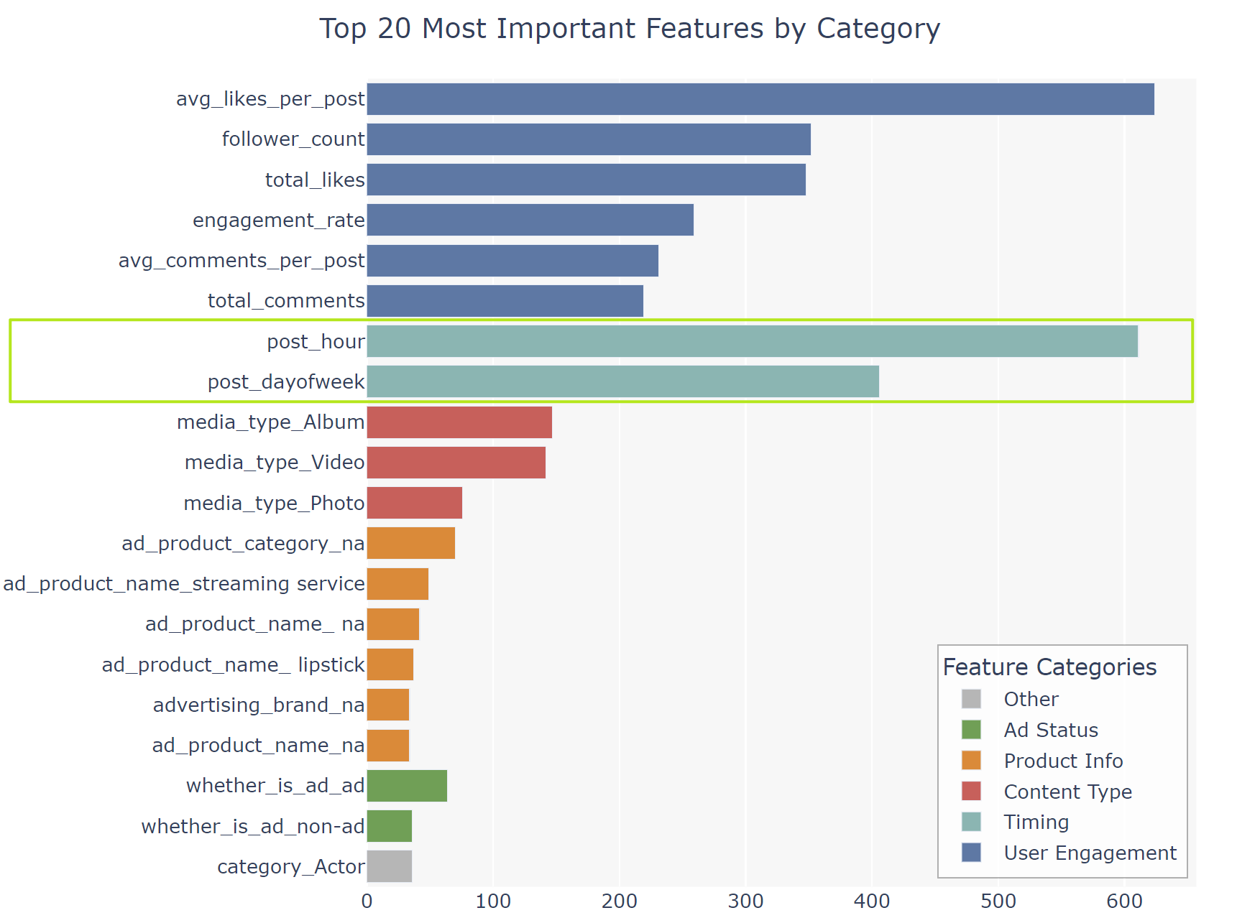
2.2 Engagement Prediction: Feature Importance Analysis
Stage 1: Recall
Stage 2: Fine-Ranking
Stage 3: Re-Ranking
Output
User Engagement Metrics Dominate
Average likes per post is the strongest predictor
Historical engagement metrics (total_likes, engagement_rate) show high importance
Follower count ranks among top 5 predictive features
Leverage user's historical engagement patterns
Timing Matters Significantly
Post hour and day of week are crucial factors
optimal posting times heavily influence engagement
Focus on timing optimization for content delivery
Content Type Impact
Videos and albums tend to have more impact than single photos, use multi-media content strategies
Product-specific Features
Product category and name have lower importance
Brand information shows limited predictive power

Slide 17
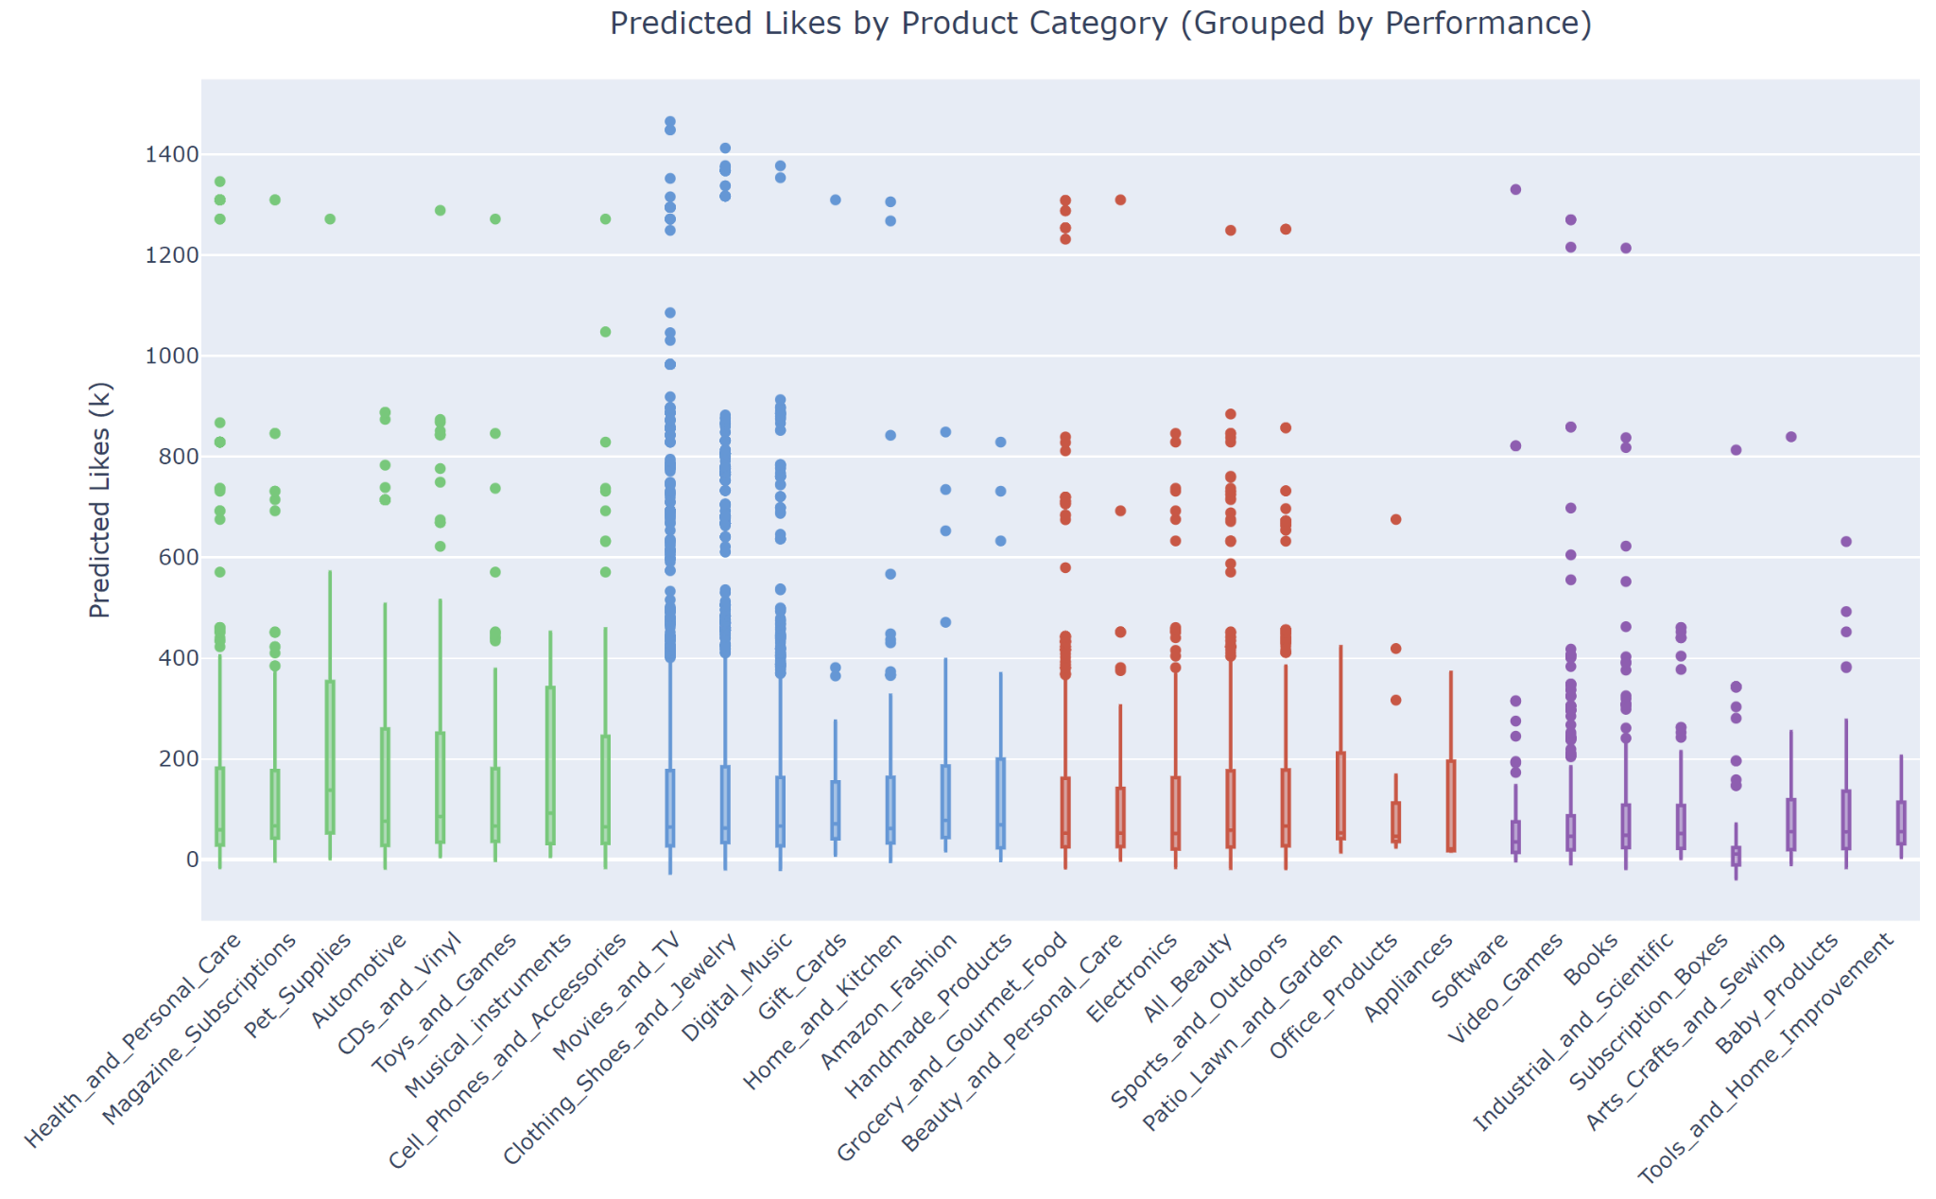
2.2 Engagement Prediction: predicted likes by category
Stage 1: Recall
Stage 2: Fine-Ranking
Stage 3: Re-Ranking
Output
Category Performance Distribution:
High Performance (Green): Categories like Health and Personal Care, Magazine Subscriptions show consistently higher predicted likes
Medium-High (Blue): Electronics, Digital Music, and Clothing categories demonstrate stable mid-to-high performance
Medium-Low (Red): Categories such as Electronics and Beauty products show moderate engagement
Low : Home Improvement and Arts & Crafts categories tend to have lower predicted likes
Business Insights:
Health-related products appear to be the most engaging category
Entertainment and personal care products dominate the top performance groups
Home and hobby-related categories need different marketing strategies to improve engagement

Slide 18
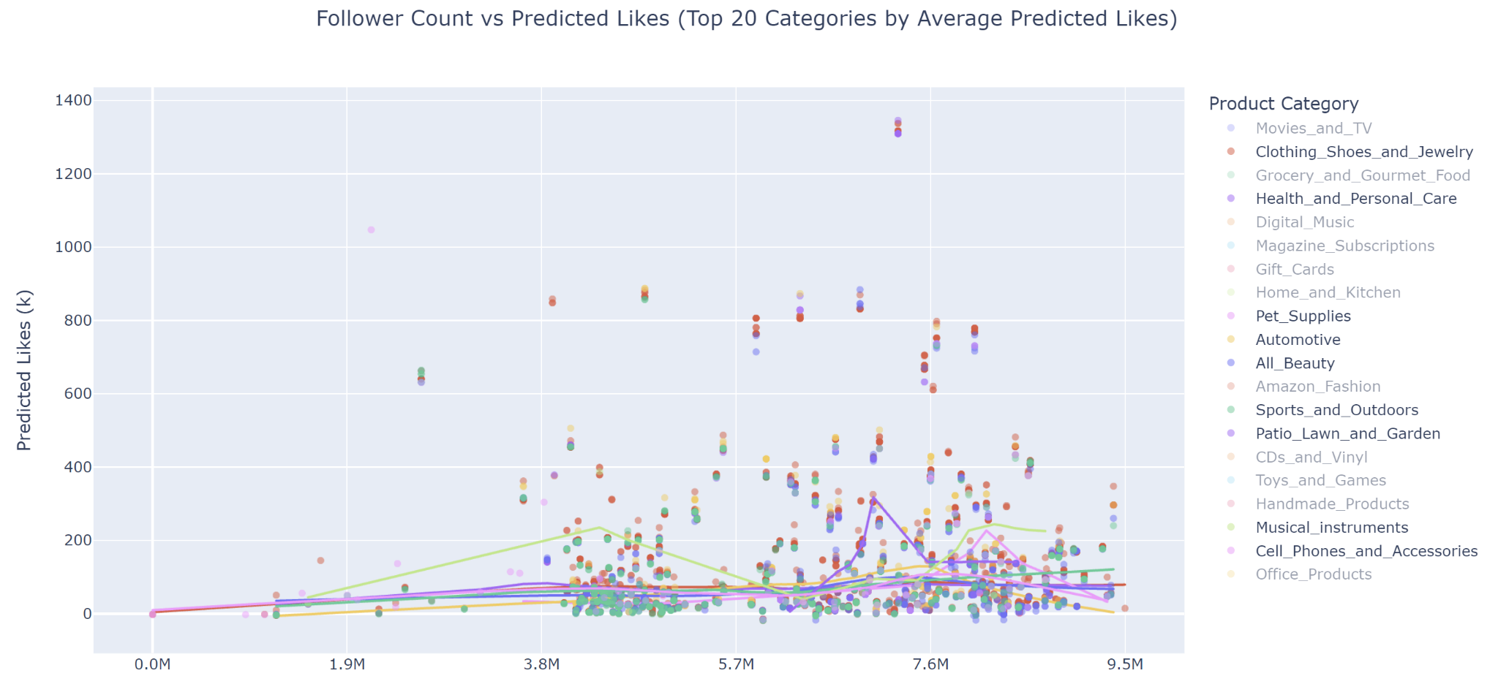
2.2 Engagement Prediction: follower count vs predicted likes
Stage 1: Recall
Stage 2: Fine-Ranking
Stage 3: Re-Ranking
Output

Slide 19
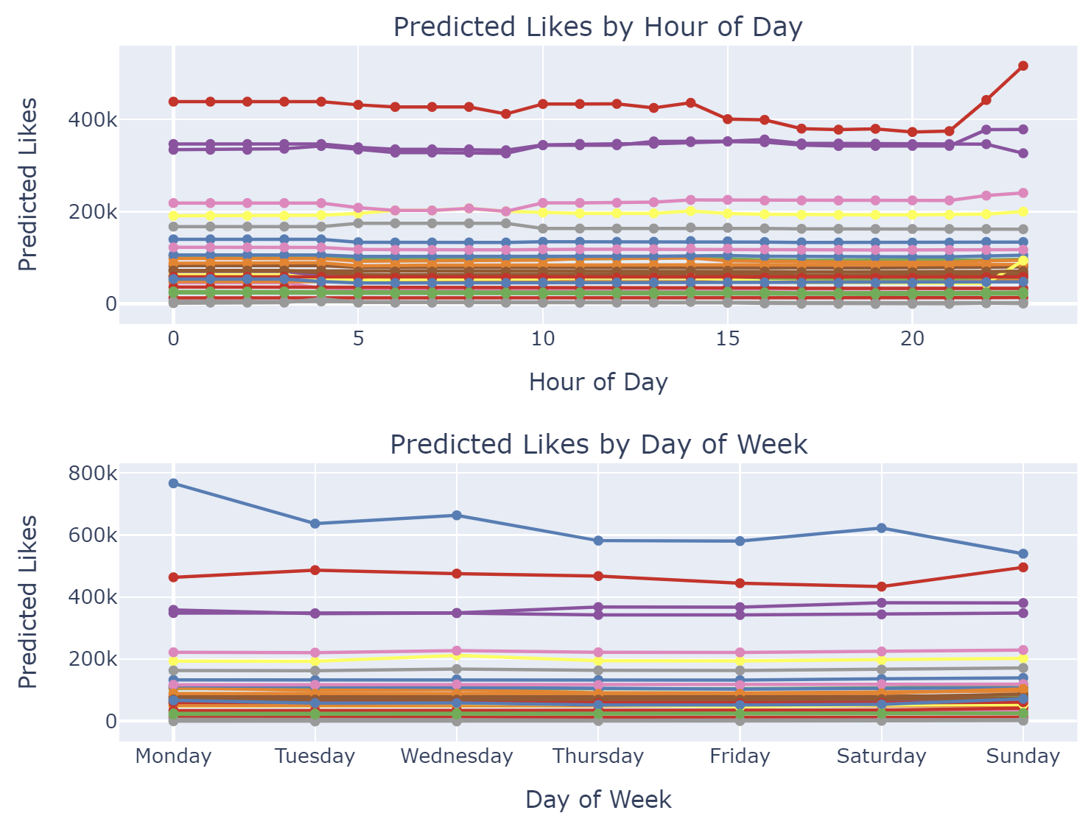
2.3 Timing Effect Analysis on User Engagement
Stage 1: Recall
Stage 2: Fine-Ranking
Stage 3: Re-Ranking
Output
Time of Day Patterns
Peak Hours
Most significant engagement peaks observed during late evening (20:00-23:00)
Notable spike at 22:00-23:00 for high-engagement influencers
User Engagement Patterns
High-engagement users show more sensitivity to posting time
Mid-tier users (100K-200K likes) maintain relatively stable engagement
Lower-engagement users show minimal time-of-day variation
Weekly Patterns
Strong Performance Days
Monday shows highest predicted engagement across most users
Mid-week (Wednesday) demonstrates stable performance
Category-Specific Trends
Fashion & Beauty users show highest engagement variability
Digital entertainment categories maintain consistent engagement

Slide 20
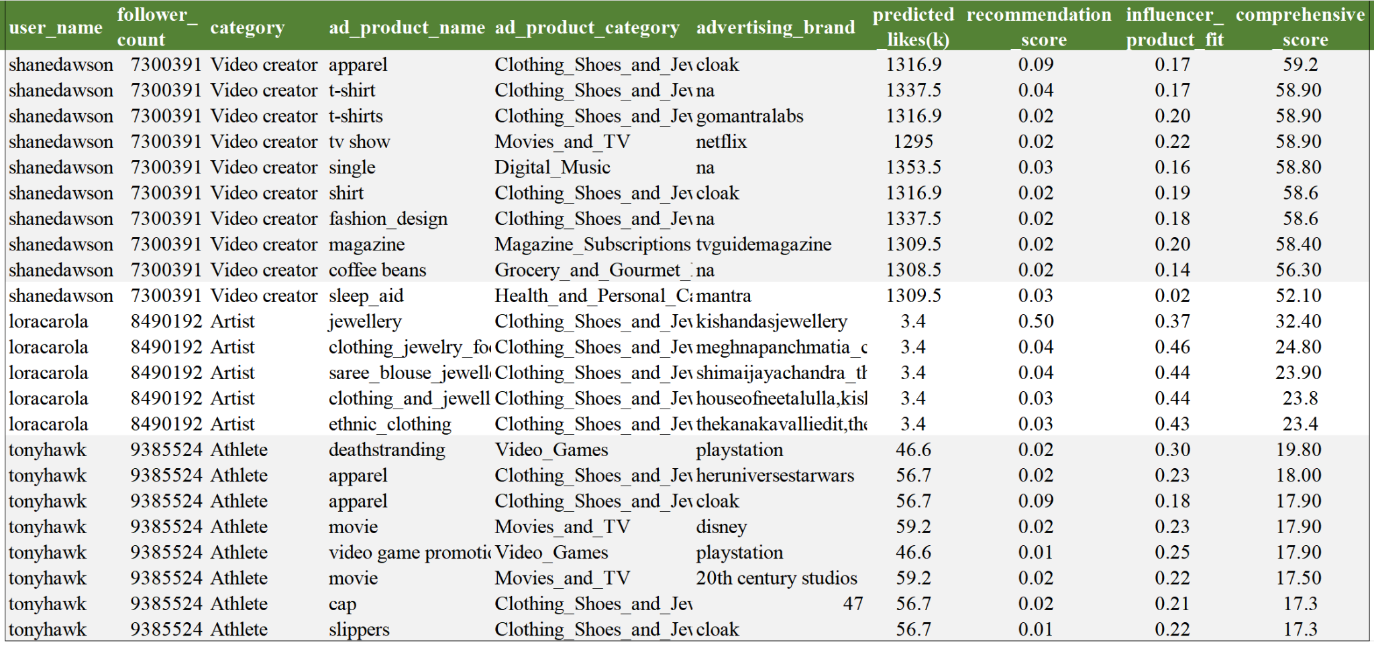
3. Compute Relevance Score and Rank Top N Products
Stage 1: Recall
Stage 2: Fine-Ranking
Stage 3: Re-Ranking
Output
Relevance Score（User B, Product P）= α × Likes+β × CollaborativeFiltering + θ × UserItemMatch

Slide 21
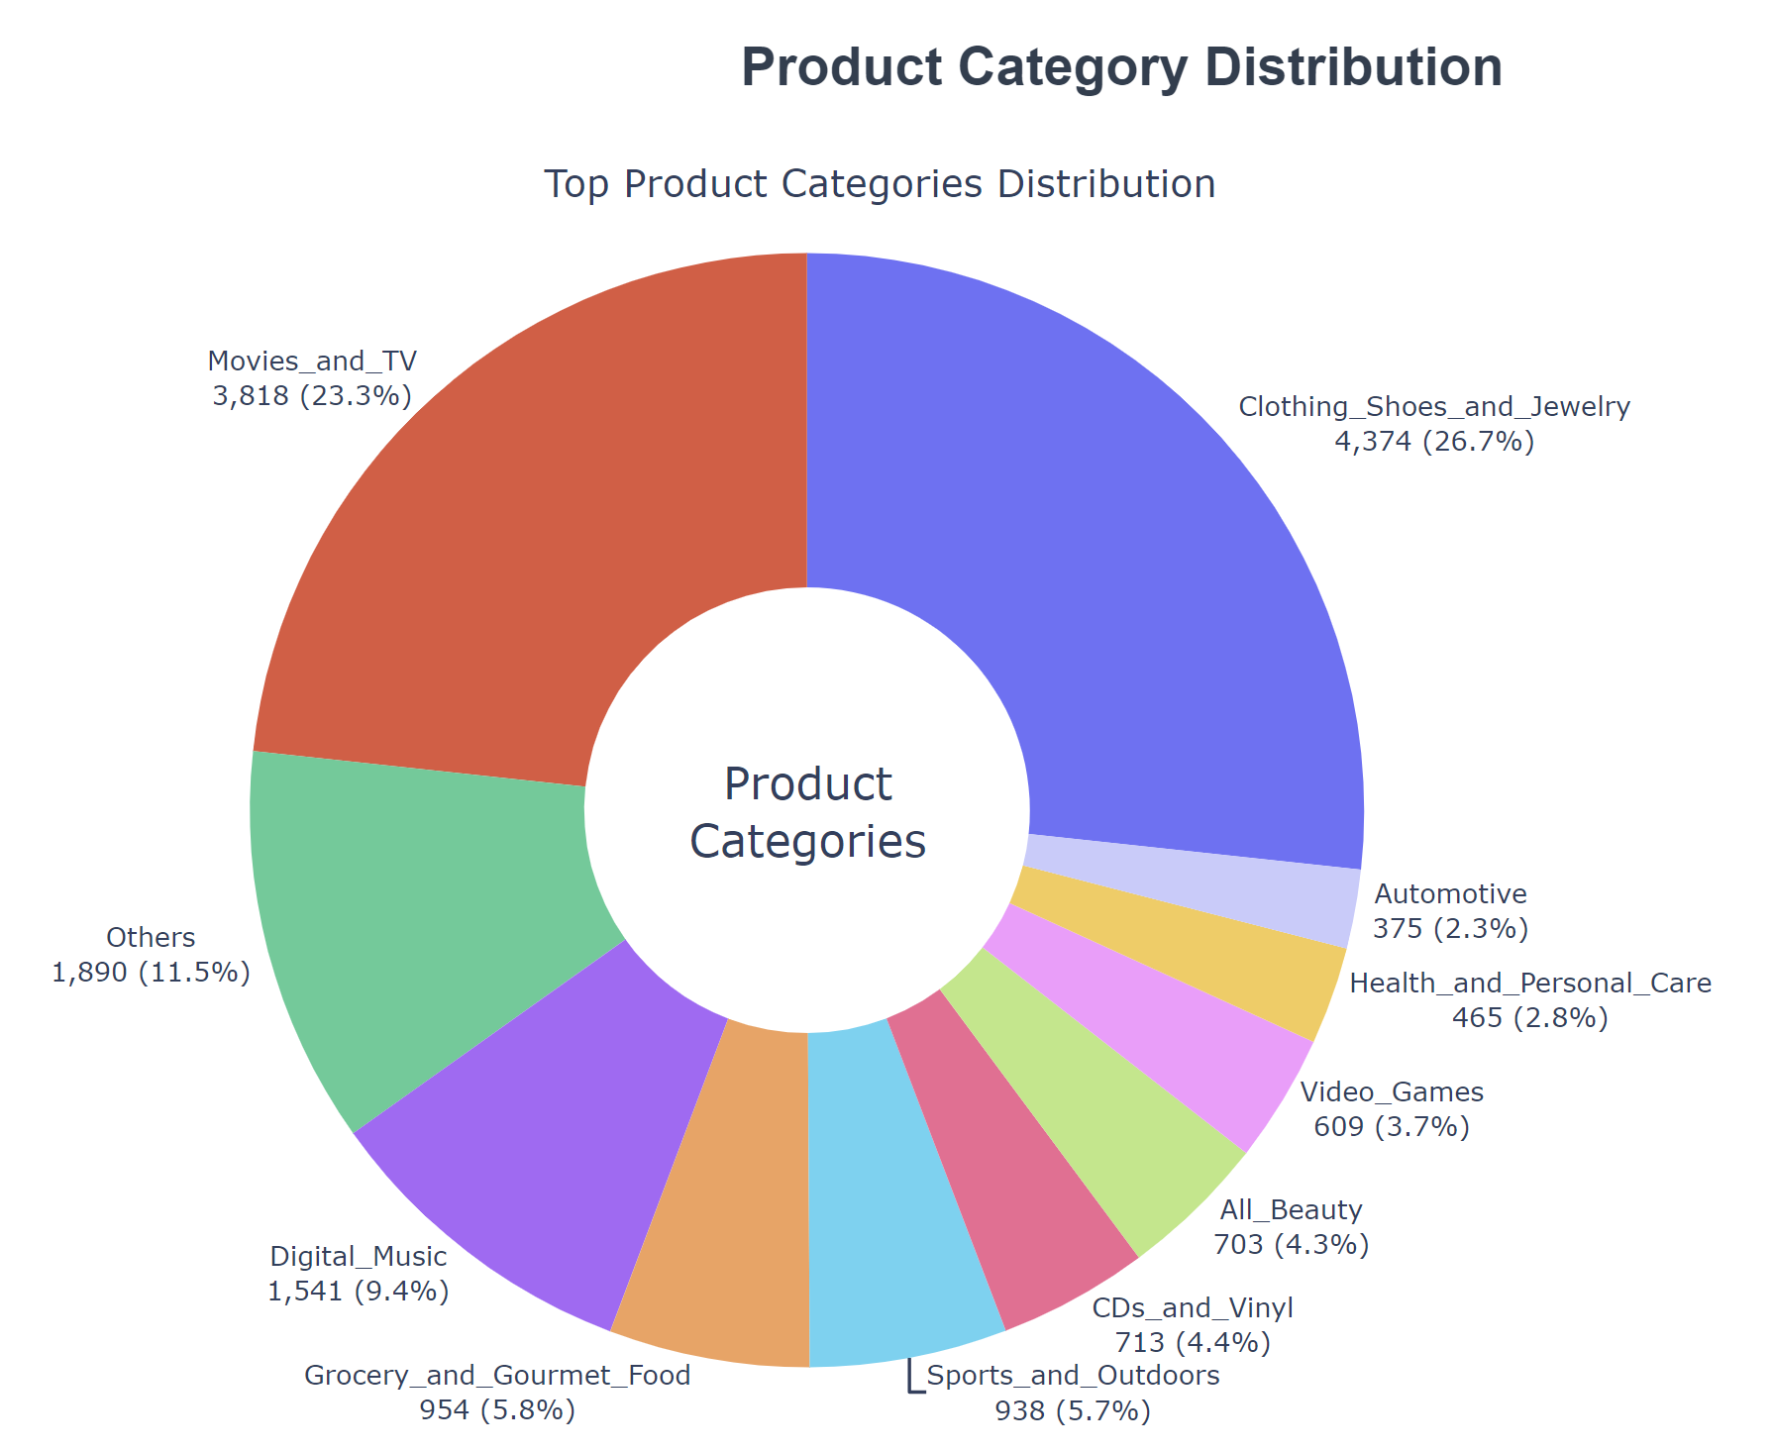
Recommendation Analysis: Product Category Distribution
Influencer Marketing Focus
Fashion dominates influencer recommendations (29.7%), suggesting this category has the highest commercial potential in social media marketing.
Entertainment content (Movies & TV, 21.0%) shows strong alignment with influencer marketing strategies
These two categories account for over 50%, indicating where the algorithm finds strongest influencer-product matches
Content Creation Opportunities
Sports/Outdoors (6.0%) and Beauty (4.8%) show moderate recommendation rates, suggesting untapped potential
Health & Personal Care (3.0%) appears underrepresented despite its high engagement rates (as seen in previous charts)
Algorithm Insights
The recommendation system shows strong preference for visual-heavy product categories
Categories with clear demographic targeting appear more frequently in recommendations

Slide 22
Goal: Generate a ranked list of Amazon product recommendations based on a candidate list of product sponsorships.
Method: Autoencoder-Based Product Recommendation System for Influencers & Amazon Products that leverages FAISS (Fast Approximate Nearest Neighbors Search) for fast product retrieval. Use PCA to reduce dimensionality.
Benefit:
Direct feature alignment isn’t possible because dimensions don’t match.
Creates a common latent space where products from two different feature pools can be compared and retrieved efficiently. This allows us to to semantically align similar but structurally different datasets.
Independent of availability or labelled data, which suits our purposes.
Stage 1: Recall
Stage 2: Fine-Ranking
Stage 3: Re-Ranking
Output

Slide 23
Methodology
Content-based filtering
Using the generated product pool, we get a sense of the types of sponsorship that are suitable to the influencer. This model matches these products with Amazon products based on feature similarity.
Dataset creation: Identified top 10 product categories based on marketability, and filter out old products or those with low ratings - Feature engineering, Sentiment analysis, and Vectorization, PCA to reduce dimensionality.
Autoencoder learns a latent space between the datasets, making it compatible to run FAISS based similarity search and retrieval.
FAISS: Generate candidate lists of top N Amazon products that are similar to each proposed sponsor product.
Re-rank all recommendations on the basis of
Recommendation frequency
Influencer-product fit
Recommendation Score

Slide 24
Autoencoders
Encoding
Decoder
Training
Pool 1 Encoder
393D - Dense Layers -> 256D - Latent space
Pool 2 Encoder
746D - Dense Layers -> 256D - Latent space
Shared latent space (256D)
Allows Pool and Pool 2 to be compared directly
The latent space captures essential similarities.
The autoencoder trains only on Pool 2, ensuring meaningful embeddings
Decoder reconstructs Pool 2 products from latent space
256D latent representation -> Dense Layers -> 746D reconstruction
Loss Function: MSE
Forces the encoder to learn meaningful feature representation
Autoencoder Training (Pool 2)
Learns meaningful compressed representations for Amazon Products
Pool 1 Encoder Training (Contrastive Loss)
Ensures Pool 1 embeddings align correctly with Pool 2 embeddings
Balanced Sampling for Pool 2
Each Batch randomly samples 16K products across categories
Hyperparameter: Latent space dimension, learning rate, loss function, training method were decided considering PCA explained variance of the feature space, visualization of loss function and dataset imbalance.

Slide 25
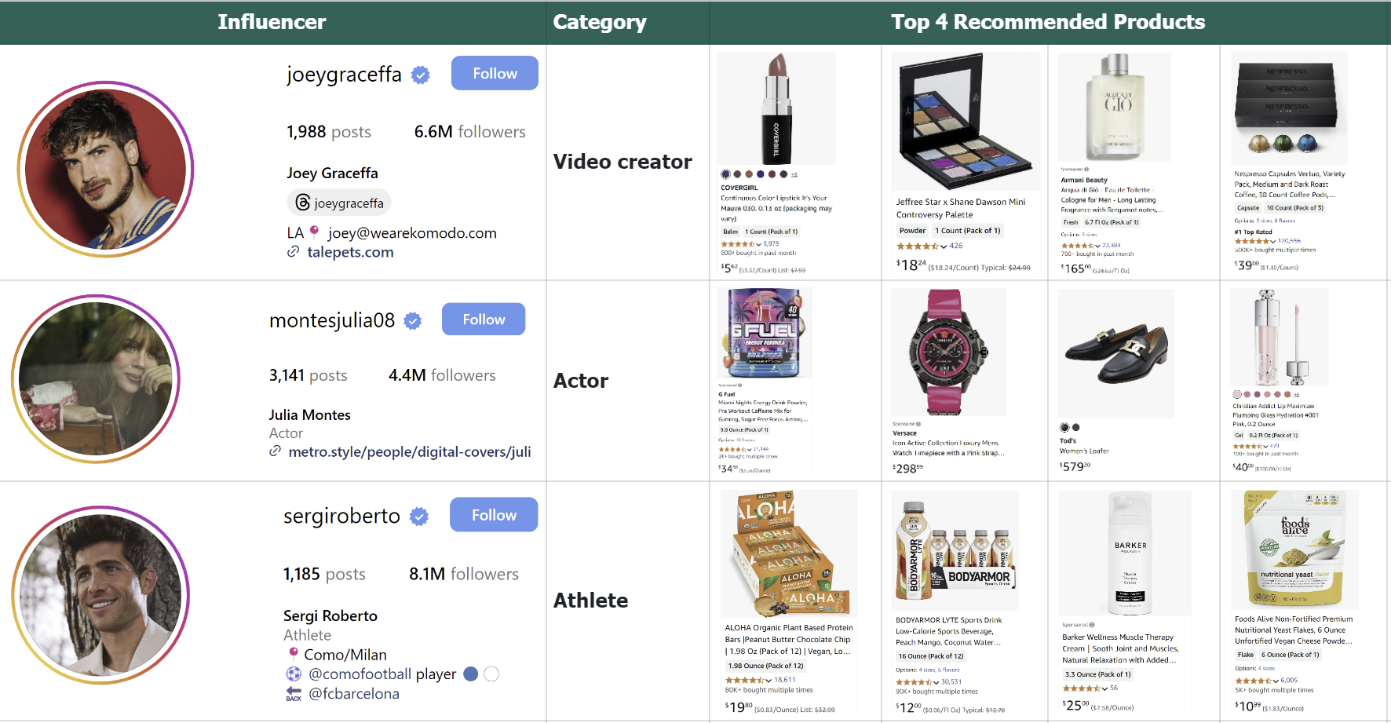
Stage 1: Recall
Stage 2: Fine-Ranking
Stage 3: Re-Ranking
Output

Slide 26
Limitations
Data Selection
Since we're using sampling to load larger categories (for faster computation), we risk losing out on good quality products that might make better recommendations.
Product pool still includes products that may not be marketable (textbooks in ‘Books’ category). Item level segregation of dataset to identify niche products will make ensure a sophisticated system.
Lack of Interpretability
The model does not explicitly learn product equivalences. The latent space could align features structurally but may not be semantically meaningful for product matching.
Feature Alignment
Pool 1 and Pool 2 have different feature distributions, but the autoencoder treats them similarly.
Pool 2 (Amazon products) contains rich textual and numerical metadata, while Pool 1 focuses more on influencer-product fit.
Cold-start Problem & Unavailable Metrics
Sales data for the Amazon product, and revenue logs of previous sponsorship campaigns would have been useful to understand the conversion between the recommendations and its ‘fit’.

Slide 27
THANK YOU!

